Slide 1
RETAIL PRODUCT DATA ANALYSIS
Conducted By
ANTARA BISWAS

Slide 2
OUTLINE
Introduction
Objective
Dataset
Methodology
Analysis Report
Insights & Suggestion

Slide 3

INTRODUCTION
Retail industry is diverse, featuring a wide array of products such as clothing, electronics, groceries, and household items.
Retailers play a crucial role in the supply chain, acting as intermediaries between manufacturers and end consumers, while also managing inventory, marketing, and customer service.
In a competitive market, retailers must constantly adapt to changing consumer preferences, technological advancements, and economic fluctuations to maintain profitability and growth.
JULY 19/2024 Paul and Rachelle Baron’s Beau & Belle Littles https://timesofindia.indiatimes.com/technology/tech-news/how-amazons-dirty-diapers-mistake-killed-this-multi-million-dollar-family-business/articleshow/111812571.cms

Slide 4
OBJECTIVE
The purpose of the analysis is to identify and analyze the following:
Return Policy Impact to refine return policies that balance customer convenience with business interests.
Inventory Optimization to ensure better inventory management decisions.
Pricing Strategy Development identifying the optimal discount levels that maximize revenue and profitability
Customer Satisfaction Analysis to understand customer preferences and improve product offerings, return policies, and overall customer satisfaction.
Also, To help retailers boost sales, profits and customer satisfaction.

Slide 5
DATASET DESCRIPTION
Brief description of each column in the dataset:
PRODUCT_ID: Unique identifier for the products.
PRODUCT_NAME: Name of the product.
CATEGORY: Category to which the product belongs.
STOCK_QUANTITY: Number of units of the product currently in stock.
SUPPLIER: Name of the supplier providing the product.
DISCOUNT: Percentage discount applied to the product.
RATING: Rating of the product based on customer reviews.
REVIEWS: Total number of customer reviews for the product.
WAREHOUSE: Name of the warehouse where the product is stored.
RETURN_POLICY: Days under which the product can be returned.
BRAND: Brand name of the product.
SUPPLIER CONTACT: Contact information for the product's supplier.
13.PRICE: Selling price of the product.

Slide 6




METHODOLOGY

Slide 7
POWER QUERY & DAX
In Power Query,Data Preprocessing
SalesRevenue =Price*Stock_Quantity
DiscountValue=Price*(Discount/100)
Profit=Price-DiscountValue
StockTurnoverRate=Price/Stock_Quantity
AdjustedPrice=Price*(1+(Reviews/1000)+(Rating/10))
RatingText =Using if else statement to segregate rating into
Very Dissatisfied,Dissatisfied,Neutral,Satisfied,Very Satisfied
In DAX,Used Aggregate function SUM for SalesVolume and Used Correlation formula to determine correl_coefficient of StockTurnOverRate and Rating

Slide 8
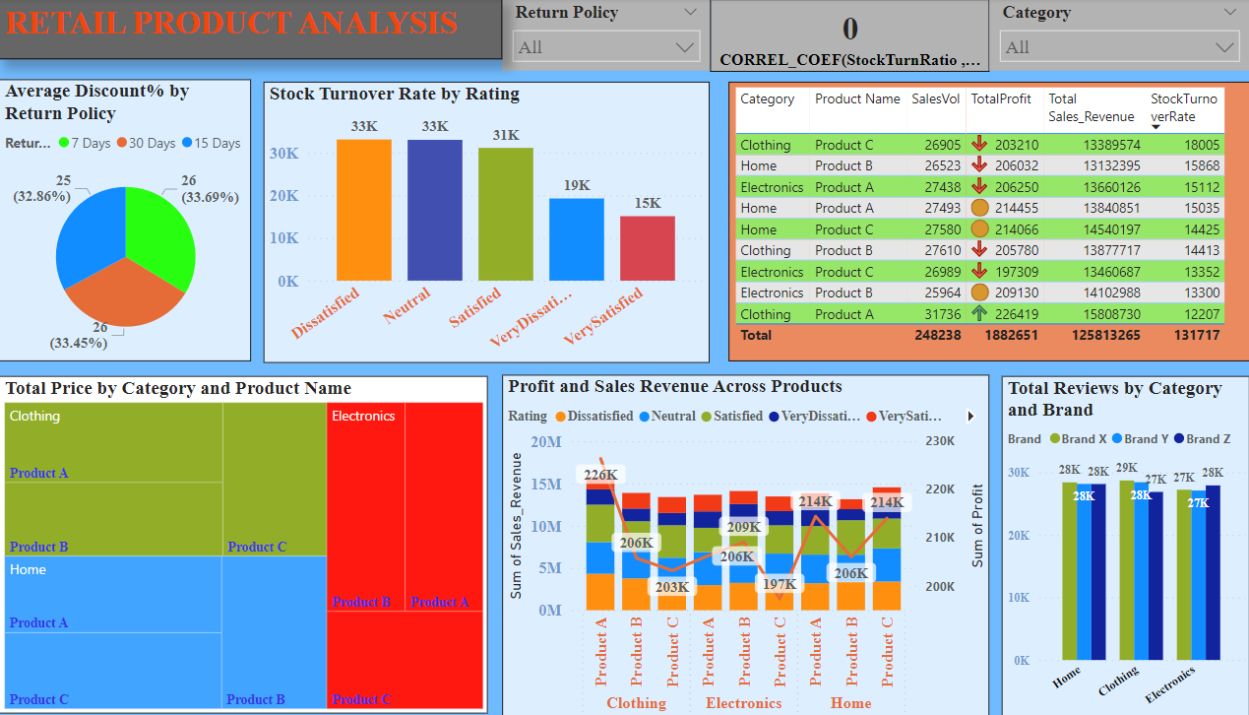
POWER BI REPORT

Slide 9
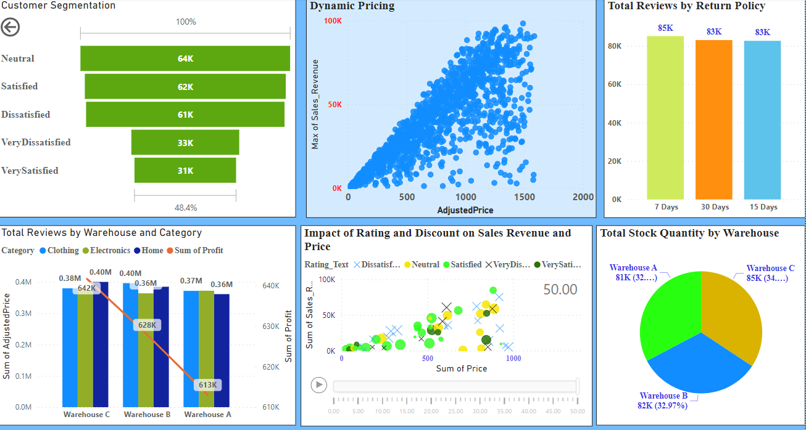

Slide 10
INSIGHTS & SUGGESTION
Average Discount % for 15 days is 25% whereas for 30 days is 25.7% where 30 days has the most Stock Turnover Rate of 13.9K.
Total Profit:640,533
Sales Revenue:43,846,731
Total Stock Turn Over Rate:41,802
Customers are most satisfied when the discount% is above 45%.
7 Day Return Policy has received Max reviews from Customer.
Among the three brands,Brand Y from Electronics make most profit than X and Z.
The correlation between Rating and Stock Turnover Rate is negligible.
The products with max Stock quantity has given the most Discount to Customer like Product A in clothing.
Home Products is making more profits than clothing and electronics.

Slide 11


